Slide 1

A Comparative Analysis of Machine Learning Algorithms
Guided by - Prof. K.B. Ray
Souvik Karmakar | 1807228
Sudeshna Dutta | 1807232
Indrashis Mitra | 1807274
Kinjal Sarkar | 1807277
Pratyay Basu | 1807291

Slide 2
Objectives -
To develop a medicine recommendation system through market basket analysis to counter the problem of medicine shortage
Study behaviour of classifiers based on their accuracy in DNA classification
Why did we do this?
Patients do not face the issue of shortage of medicines - they can get whatever medicine they want,at any time
Pharmacists can understand which medicines are being brought most,so that they can adequately stock them,thus not having to turn down customers and profiting from their business
No shortage in medicine supply means elimination of medical black market,thus helping in growth of economy
Study of classifiers would lead to better informed choices related to the use of medicines based on genetic characteristics

Slide 3
What is the Apriori Algorithm?
Apriori algorithm, a classic algorithm, is useful in mining frequent itemsets and relevant association rules. Usually, this algorithm is operated on a database containing a large number of transactions.
It was given by Rakesh Agrawal and R Srikant in 1994.
Apriori - An odd name
It has got this odd name because it uses ‘prior’ knowledge of frequent itemset properties.

Slide 4
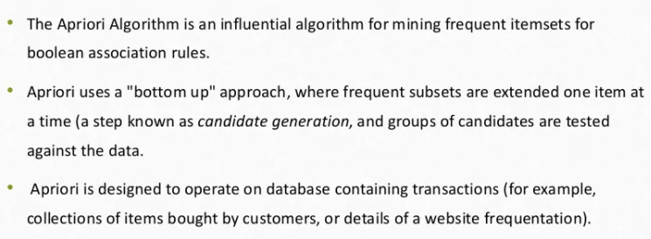
Definition of Apriori algorithm

Slide 5
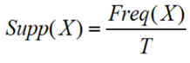
Theory
Three significant components comprise the apriori algorithm. They are as follows.
Support
Confidence
Lift
Support - The frequency of X, or how frequently an item appears in the collection, is called support. It's the percentage of the transaction T that has the itemset X in it. If there are X datasets, the following may be written per transaction T:

Slide 6
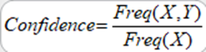
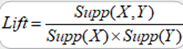
Confidence - The degree of confidence in a rule reflects how often it is correct. Or, since the incidence of X is already known, how frequently the elements X and Y appear together in the dataset. It's the proportion of a transaction including X and Y to the number of records containing X and Y.
Lift - is the strength of any rule. It is the ratio of the observed support measure and expected support if X and Y are independent of each other. It has three possible values:
●Lift = 1: Antecedent and subsequent occurrence probabilities are independent of one another.
●Lift > 1: Determines the degree to which the two itemsets are interdependent.
●Lift < 1: It indicates that one object is a replacement for another, implying that one item causes harm to another.

Slide 7
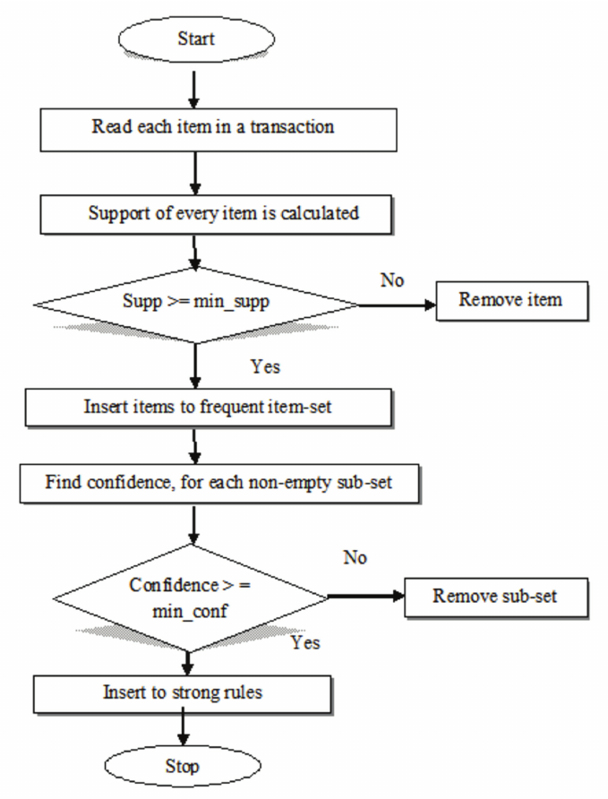
Steps to apply Apriori algorithm

Slide 8
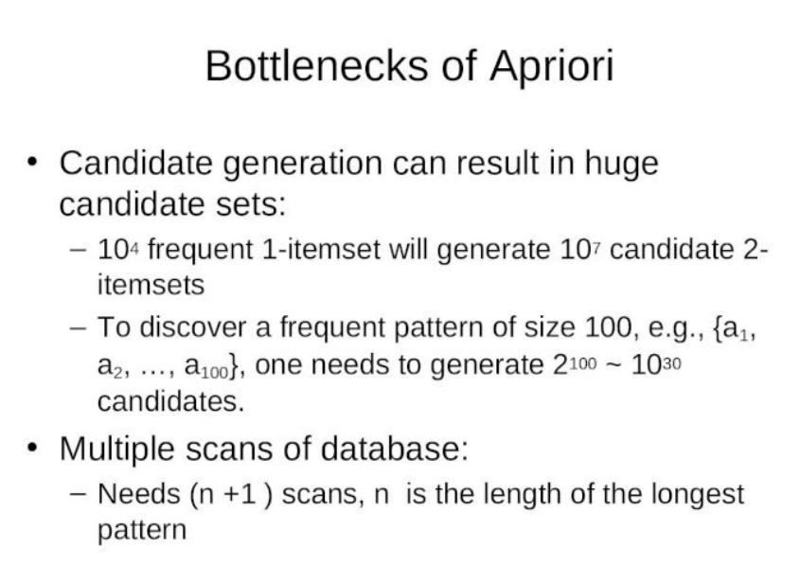

Slide 9
The ECLAT algorithm stands for Equivalence Class Clustering and bottom-up Lattice Traversal.
It is one of the popular methods of Association Rule mining. It is a more efficient and scalable version of the Apriori algorithm.
While the Apriori algorithm works in a horizontal sense imitating the Breadth-First Search of a graph, the ECLAT algorithm works in a vertical manner just like the Depth-First Search of a graph.
This vertical approach of the ECLAT algorithm makes it a faster algorithm than the Apriori algorithm.

Slide 10
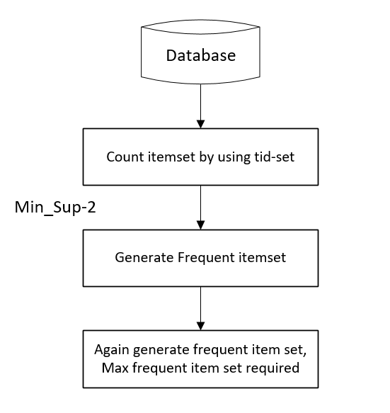
Steps to apply ECLAT algorithm

Slide 11
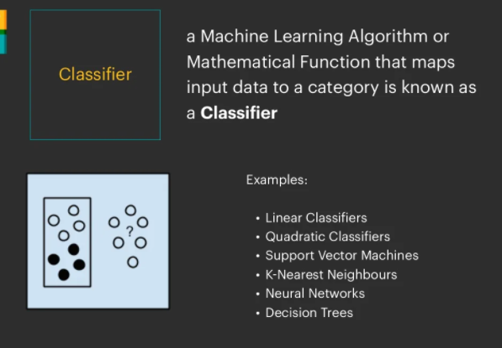

Slide 12
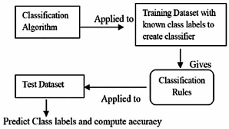
Steps involved in classification

Slide 13
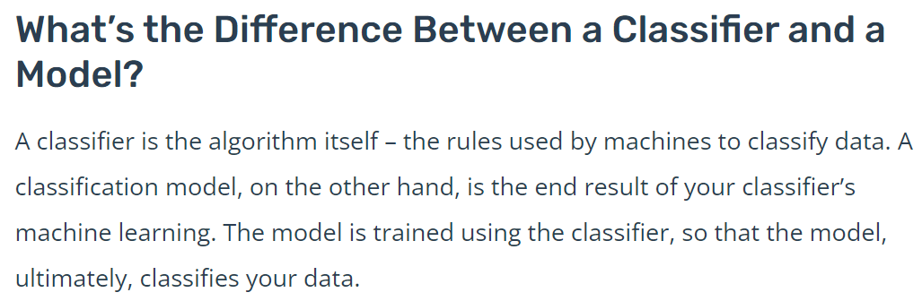
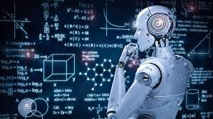

Slide 14
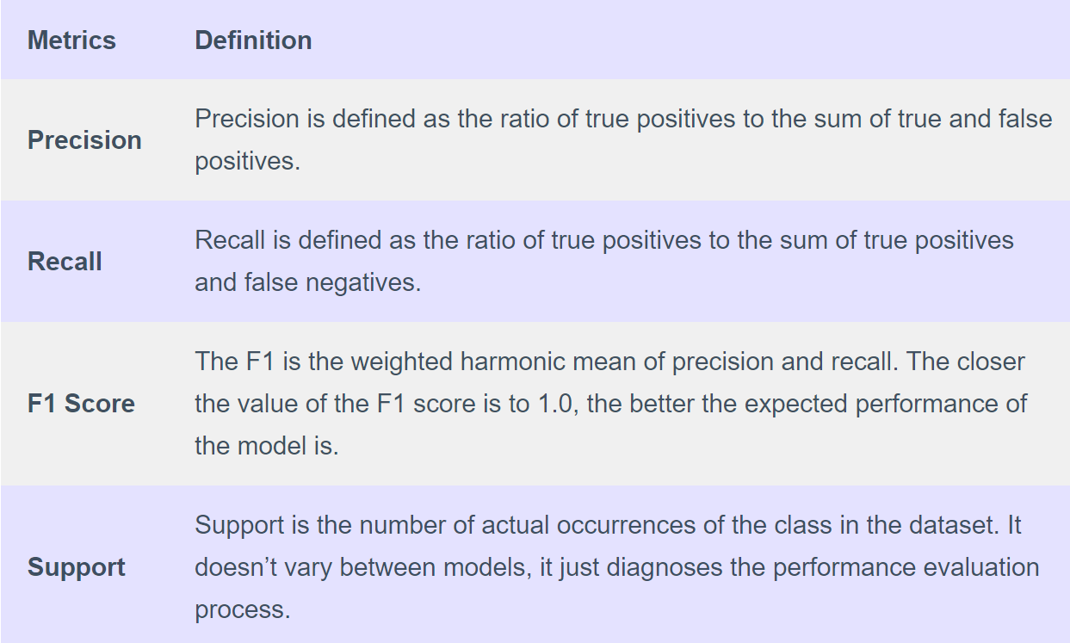
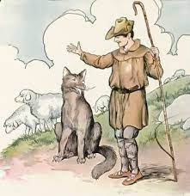
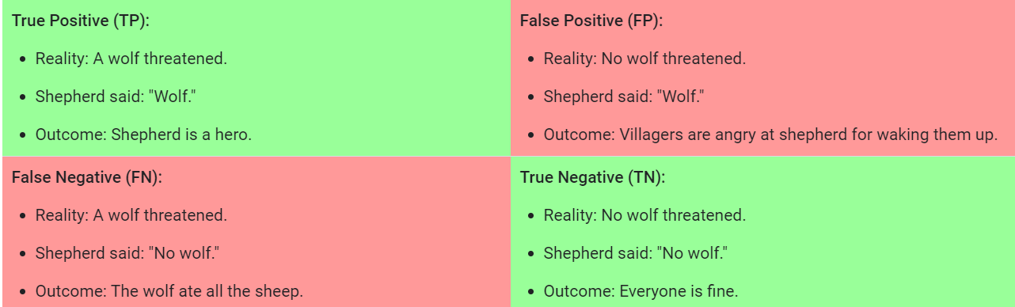
Metrics in a classification report

Slide 15
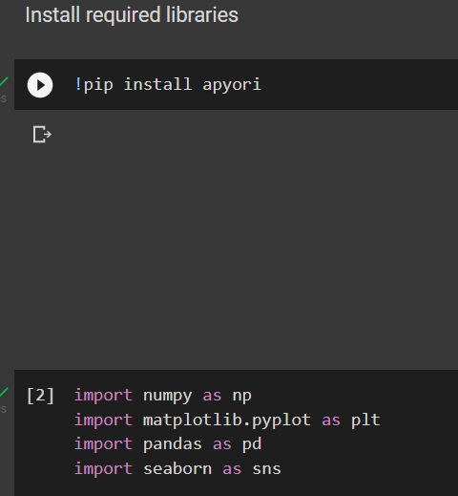
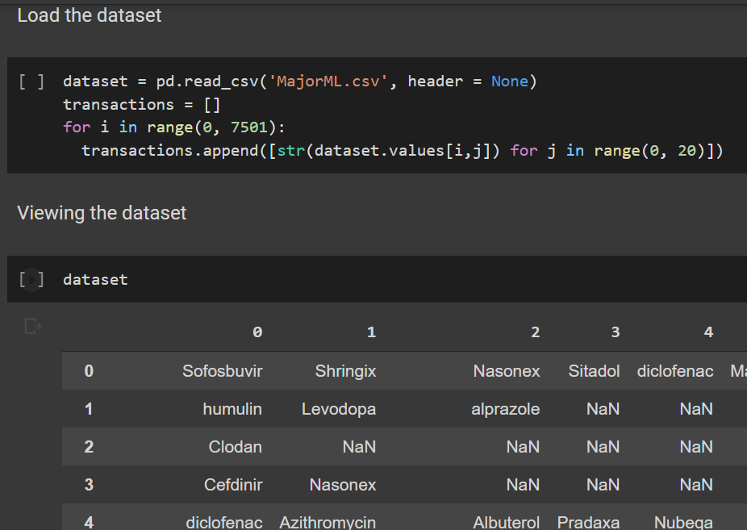
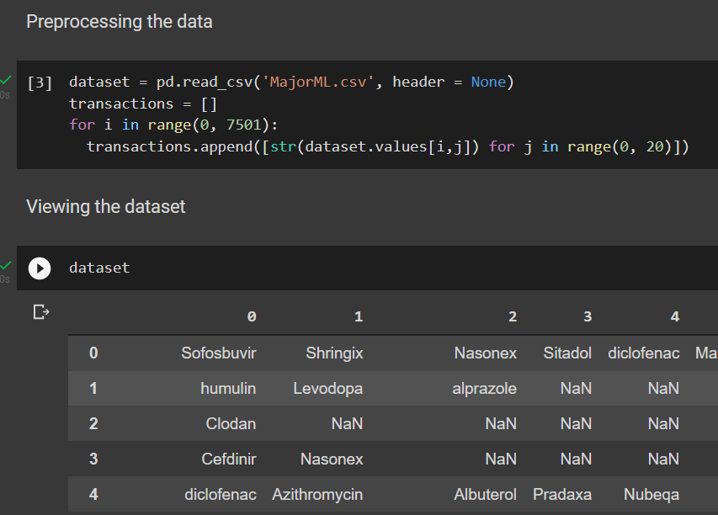
A look at the code behind our model(1)

Slide 16
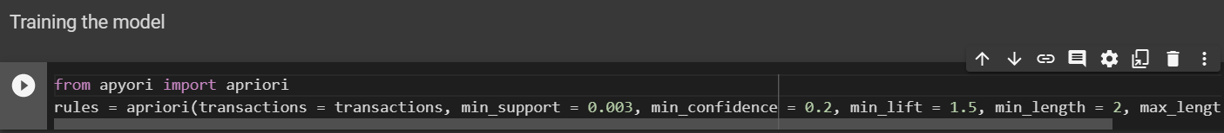
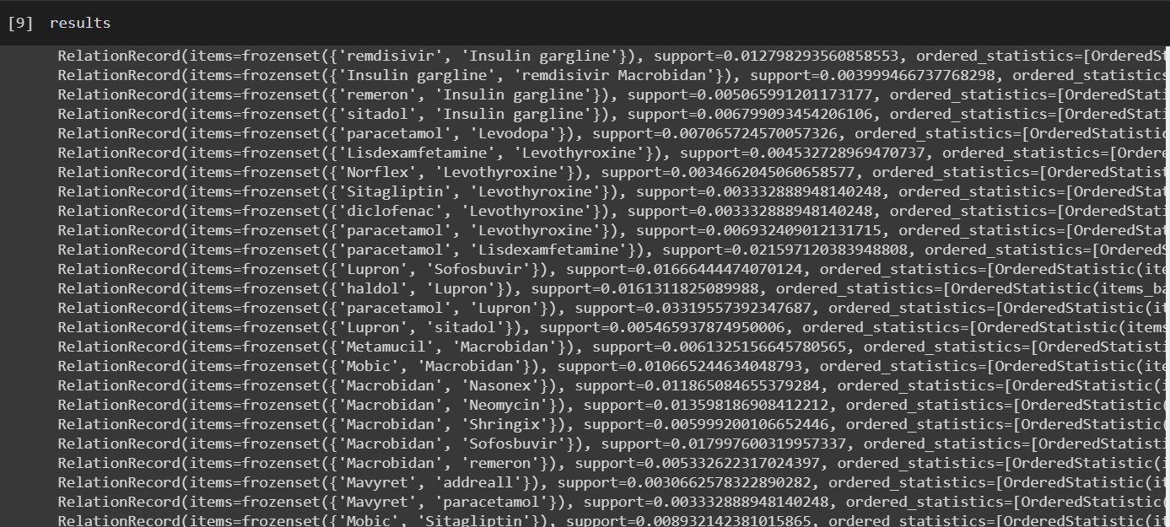
A look at the code behind our model(2)

Slide 17
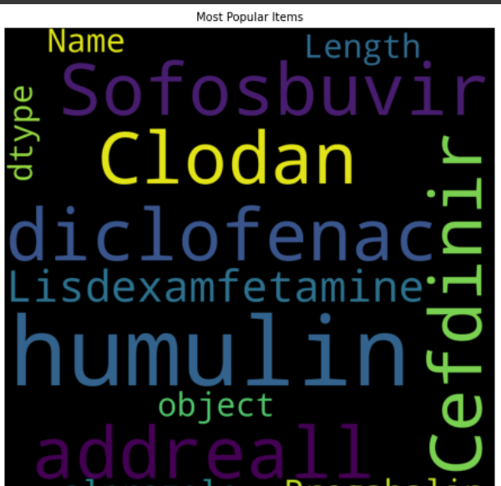
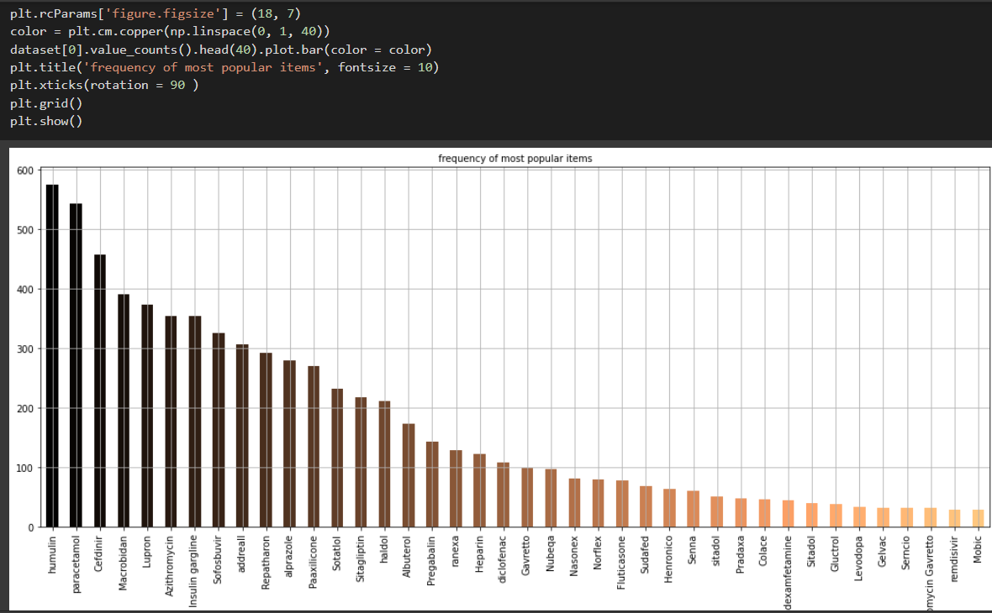
Visuals
Visuals

Slide 18
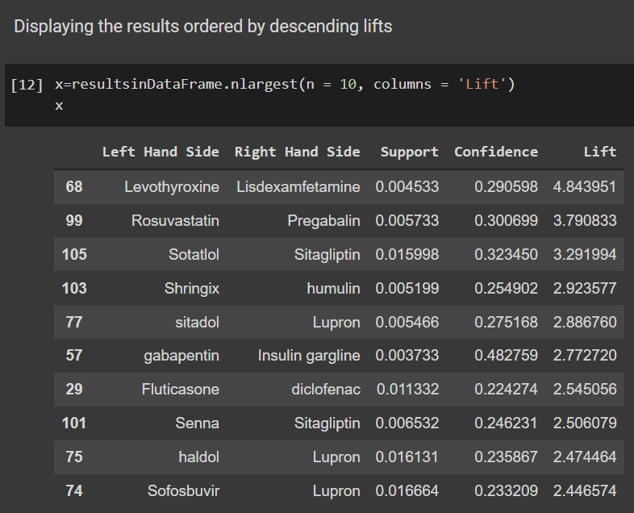
Results
Higher lift
=
more association between elements

Slide 19
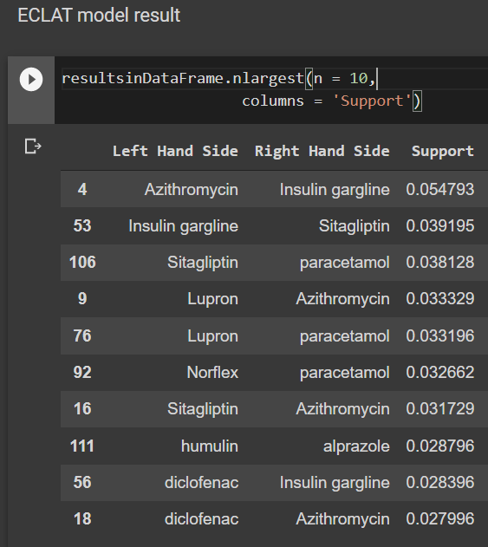
More support
=
greater likelihood of being bought together

Slide 20
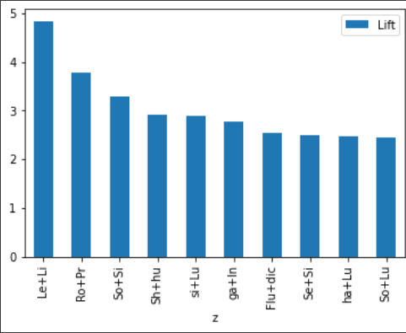
Representation of the top-10 medicines bought together - Apriori

Slide 21
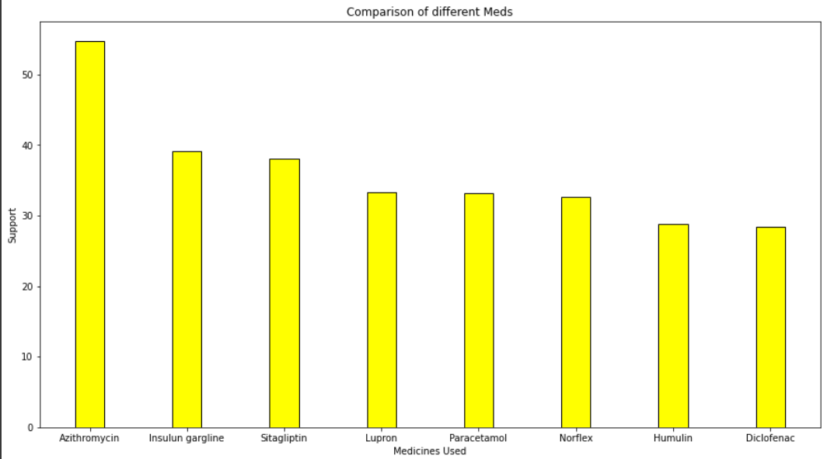
Representation of the most popular drugs - ECLAT

Slide 22
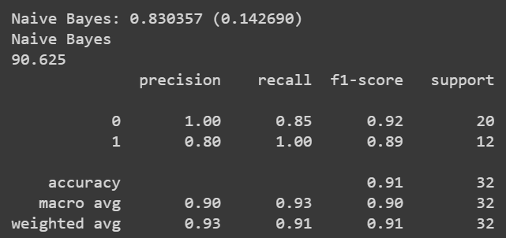
Classification report showing various metrics to measure performance

Slide 23
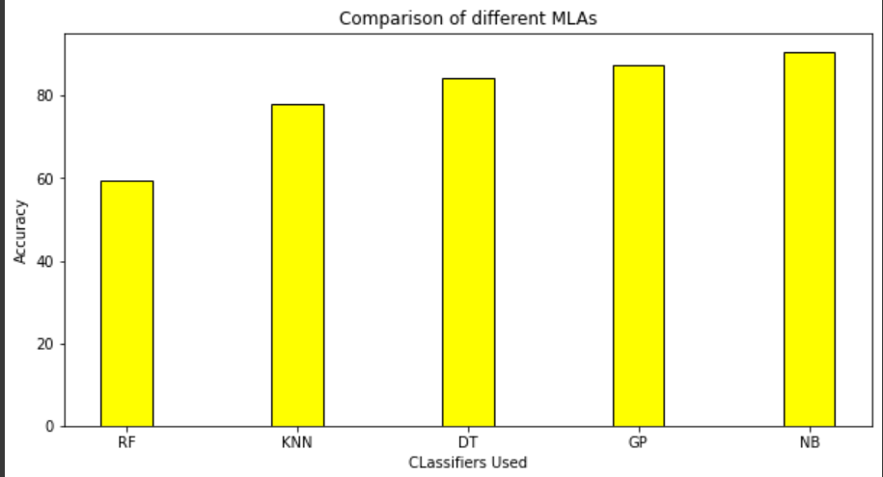
Comparison of various classifiers based on their accuracy

Slide 24
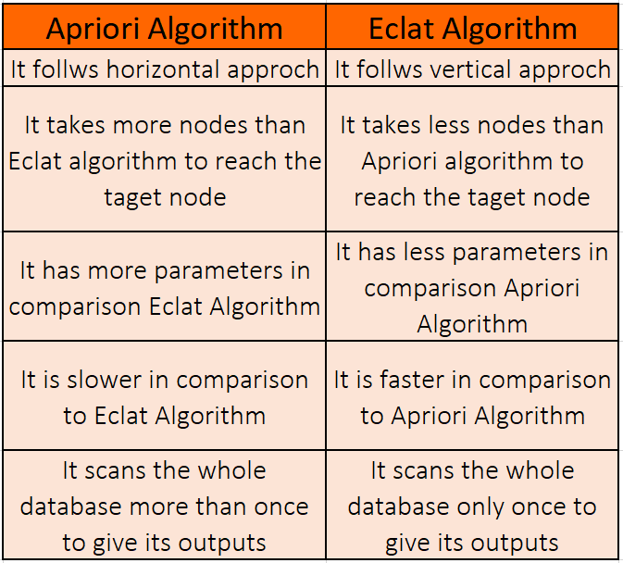

Slide 25
Future Scope
This model will recommend the best associated combination of medicines that go along with each other in a certain manner based on the previous sales of those medicines. Thus it allows optimal transactions to happen between the patient and the chemist.
Moreover , it allows the chemist to update his/her stocks to its full potential at any given point of time so that the patient can get the best possible variants of the medicines , whenever he/she needs it .
Furthermore,this will also allow lead to infrastructural casualties in a healthcare center as it will always ensure that the best possible medicine or other health equipment are available at all times of the year . This will boost the lack of technical and managerial policies that are lacking today in different healthcare centres across India .
The model can be further enhanced with UI/UX design which will allow a patient and his/her family to get a clear visual understanding of the current status of the different healthcare facilities that are available at a healthcare center.

Slide 26
References
[1]. P. S. Mung and S. Phyu. Effective analytics on healthcare big data using ensemble learning. In 2020 IEEE Conference on Computer Applications(ICCA), pages 1–4, 2020.
[2]. Samer Ellahham, Artificial intelligence in the diagnosis and management of COVID-19: a narrative review, Journal of Medical Artificial Intelligence,2021
[3]. Dave DeCaprio, Joseph Gartner, Carol J. McCall, Thadeus Burgess, Kristian Garcia, Sarthak Kothari, Shaayaan Sayed, Building a COVID-19 vulnerability index, Journal of Medical Artificial Intelligence,2020
[4]. Dharavath Ramesh, Pranshu Suraj, and Lokendra Saini. Big data analytics in healthcare: A survey approach. In 2016 International Conference on Microelectronics, Computing and Communications (MicroCom), pages 1–6. IEEE, 2016
[5]. Munira Ferdous, Jui Debnath and Narayan Ranjan Chakraborty,Machine Learning Algorithms in Healthcare: A Literature Survey .In 11th International Conference on Computing, Communication and Networking Technologies (ICCCNT),2020.
[6]. Shweta Ganiger and KMM Rajashekharaiah. Chronic diseases diagnosis using machine learning. In 2018 International Conference on Circuits and Systems in Digital Enterprise Technology (ICCSDET), pages 1–6. IEEE, 2018.
[7]. Pahulpreet Singh Kohli and Shriya Arora. Application of machine learning in disease prediction. In 2018 4th International Conference on Computing Communication and Automation (ICCCA), pages 1–4. IEEE, 2018.

Slide 27
Publications
1. Paper presented in International Conference on Robotics, Control and Computer Vision (ICRCCV 2022)
I Mitra, S Karmakar , KB Ray and T Kar , Apriori based medicine recommendation system, as Proceedings in: International Conference on Robotics, Control and Computer Vision (ICRCCV),Springer ,2022.
To be published by Springer as proceedings in Lecture Notes in Electrical Engineering series. (Communicated)
2. Book chapter titled “IoMT based Smart Health Monitoring: The Future of Health Care” in BDAF-IOT-2021 edited CRC Book entitled “Big data analytics in Fog-enabled IoT Networks: towards a privacy and Security perspective approach” . (Communicated)
I. Mitra, Y. Srivastava, KB Ray and T. Kar, “IoMT based Smart Health Monitoring: The Future of Health Care” in Big data analytics in Fog-enabled IoT Networks : towards a privacy and Security perspective approach.

Slide 28
THANK YOU

